Slide 1

Credit Card Fraud Detection
Fraud detection is a set of activities that are taken to prevent money or property from being obtained through false pretenses. Fraud can be committed in different ways and in many industries. Most detection methods combine a variety of fraud detection datasets to form a connected overview of both valid and non-valid payment data to make a decision. The Credit Card Fraud Detection Problem includes modeling past credit card transactions with the knowledge of the ones that turned out to be a fraud. This model is then used to identify whether a new transaction is fraudulent or not. The models to be used will be two unsupervised algorithms such as Local Outlier Factor and Isolation Forest Algorithm. The model will
also include a supervised learning algorithm which will be Random Forest and XGBoost . My aim here is to detect 100% of the fraudulent transactions while minimizing the incorrect fraud predictions.

Slide 2

This project aims to apply different algorithms & techniques on Credit Card Fraud data set and compare the results.
Measures used to compare those are Precision and Recall.
Measure like Accuracy is not good because the data set is highly unbalanced.
MAIN GOAL

Slide 3

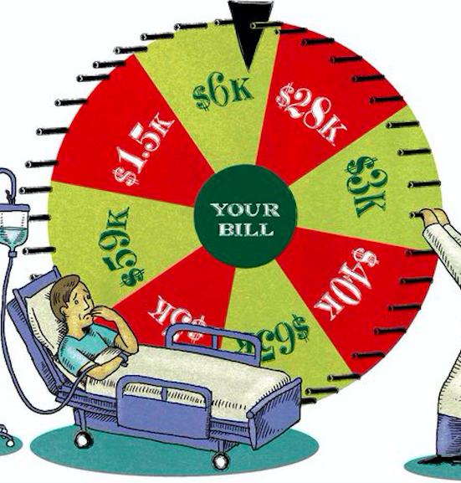
DATASET
The datasets contains transactions made by credit cards. This dataset presents transactions that occurred in two days, where we have 492 frauds out of 284,807 transactions. The dataset is highly unbalanced, the positive class (frauds) account for 0.172% of all transactions.
Due to confidentiality reasons, dataset available is not the original (raw) form but has been reduced using PCA. And the only features which have not been transformed with PCA are 'Time' and 'Amount’.
Weblink:
https://www.kaggle.com/mlgulb/creditcrdfraud/download

Slide 4
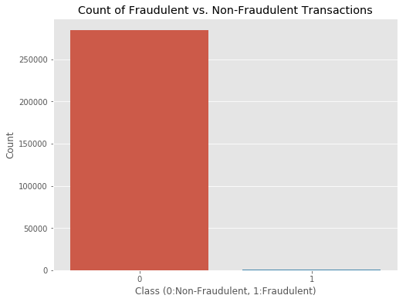
In the class distribution we want to know:
How many transactions are fraudulent and how many are not?
Well, as can be expected, most transactions are non-fraudulent. In fact, 99.83% of the transactions in this data set were not fraudulent while only 0.17% were fraudulent..

Slide 5
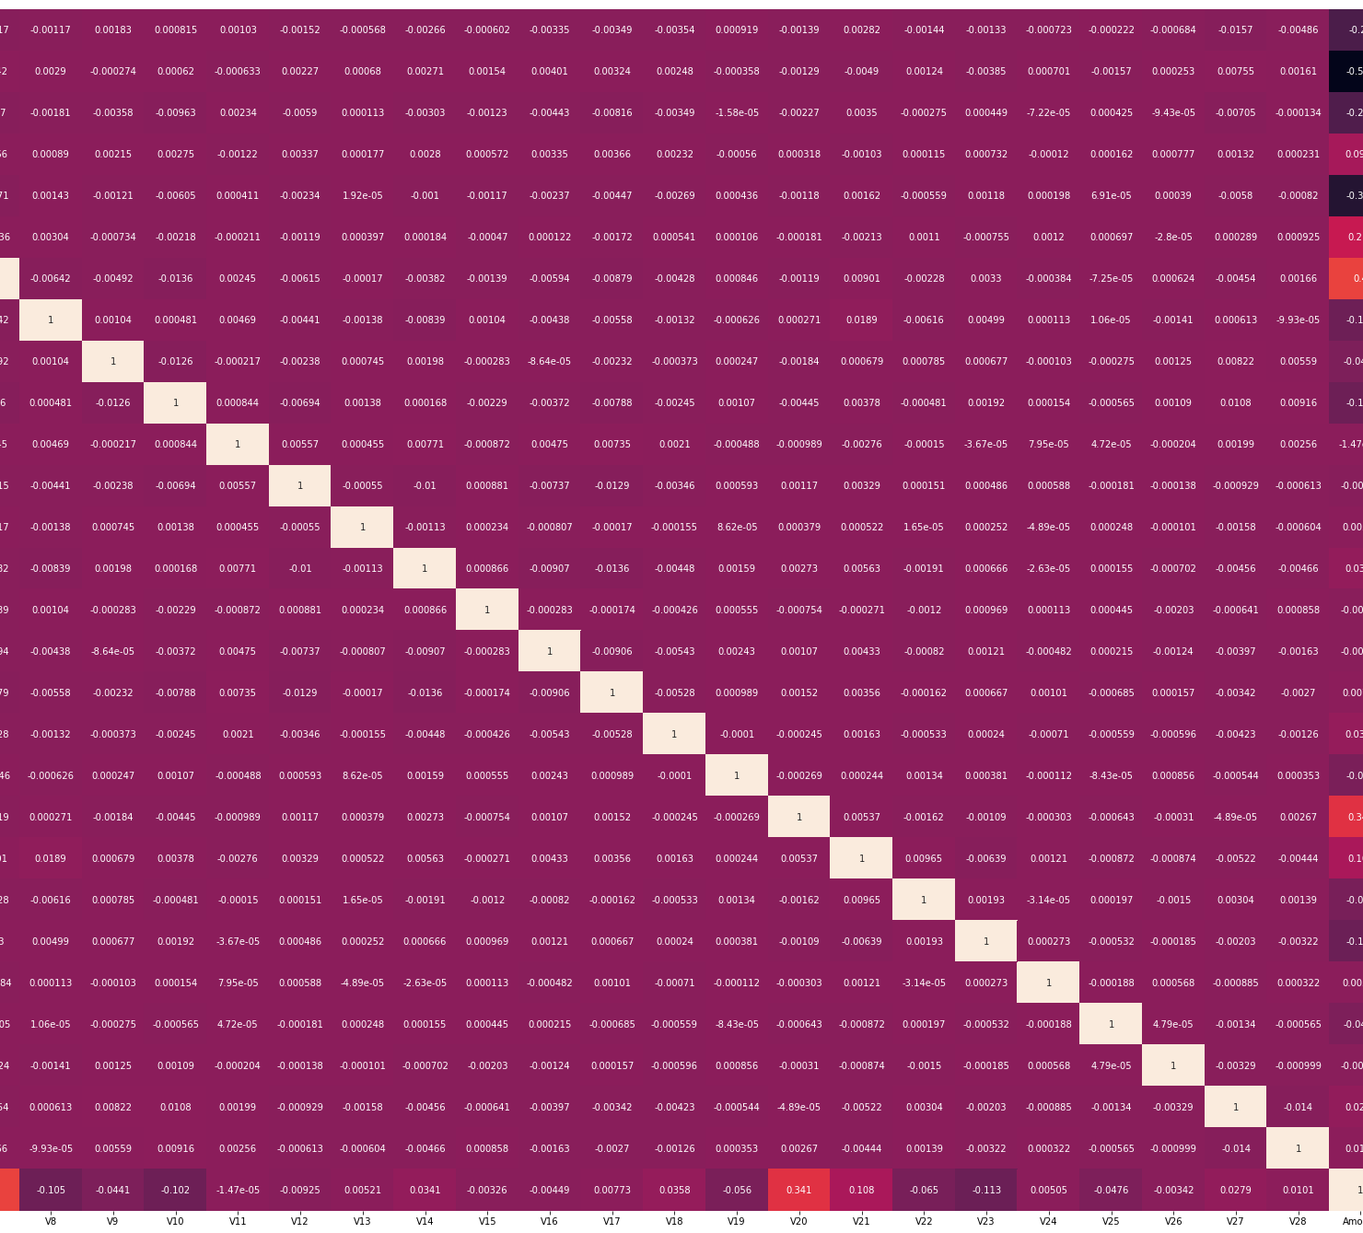
EDA
The purpose of EDA is to enhance our understanding of trends in the dataset without involving complicated machine learning models. Oftentimes, we can see obvious traits using graphs and charts just from plotting columns of the dataset against each other.
A correlation map (or correlation matrix) is a visual tool that illustrates the relationship between different columns of the dataset. The matrix will be lighter when the columns represented move in the same direction together, and it will be darker when one column decreases while the other increases. Strong spots of light and dark spots in our correlation matrix tell us about the future reliability of the model.
From these column values, we can see that there are some very useful correlations present within our new dataset. For example, V2 and V5 are highly negatively correlated with the feature called Amount. We also see some correlation with V20 and Amount. This gives us a deeper understanding of the Data available to us.

Slide 6
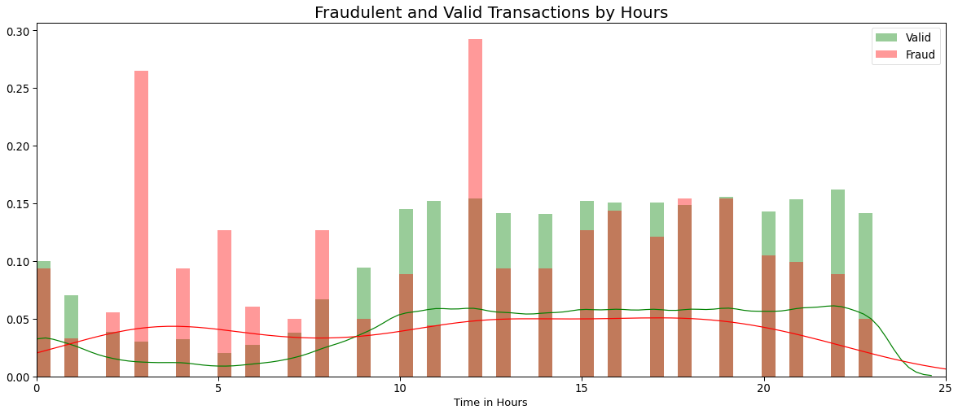
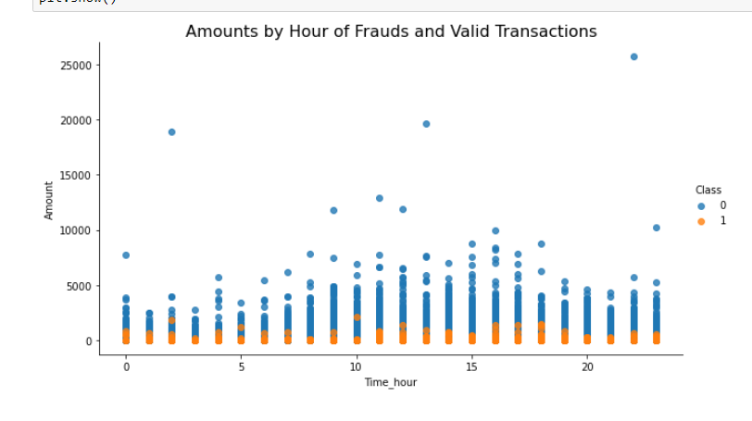
Exploring the distribution by Class types through hours
As we can see ,the most fraudulent transactions happening at 3, 12 o'clock. Fraudulent transactions of the same account didn't happen consecutively.
From the Scatter plots it is clearly visible that there are frauds only on the transactions which have transaction amount approximately less than 2500. Transactions which have transaction amount approximately above 2500 have no fraud.

Slide 7
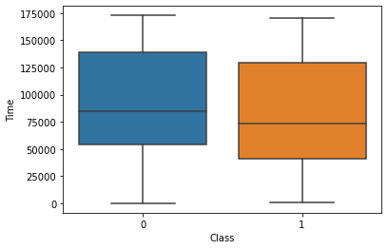
Let’s also plot a pie chart of the distribution between fraud and not-fraud for easier viewing.
By looking at the box plot we can say that both fraud & valid transactions occur throughout time and there is no distinction between them.

Slide 8
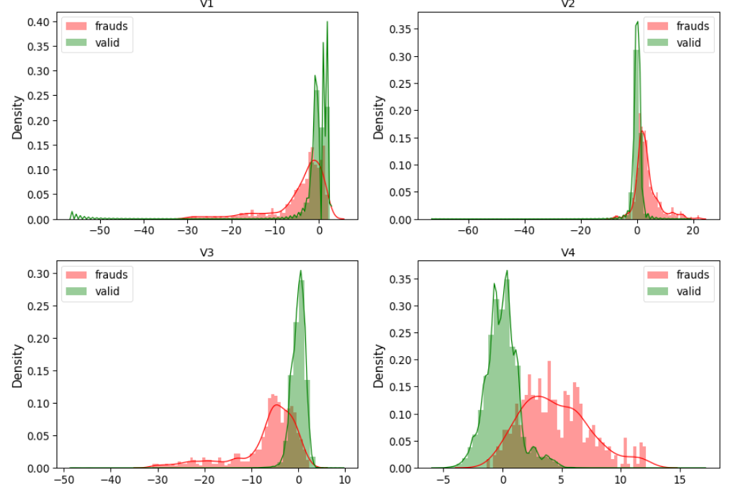
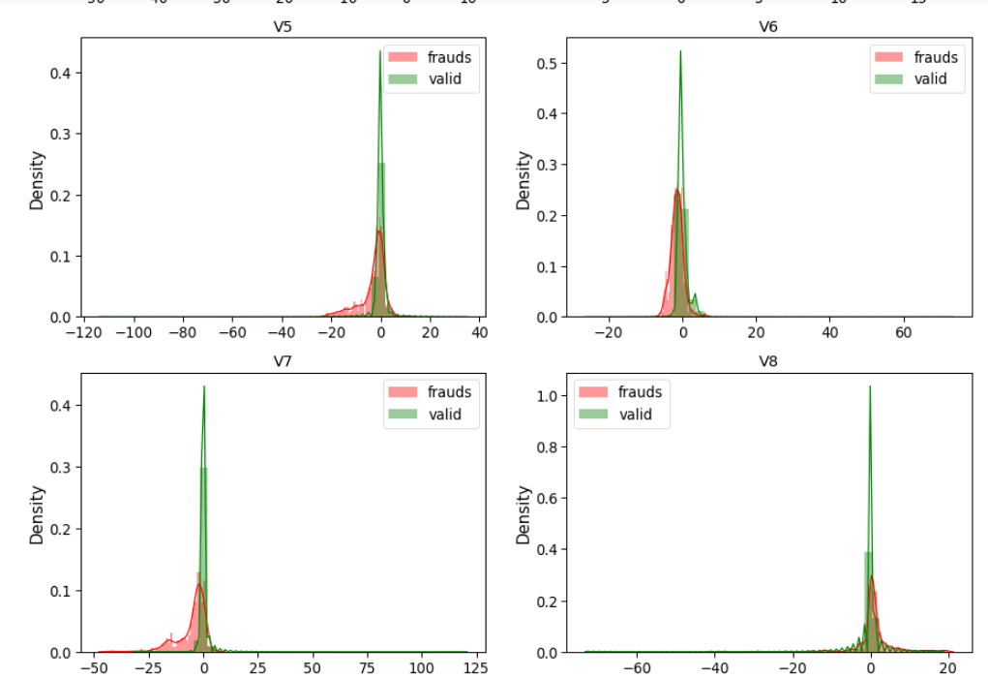
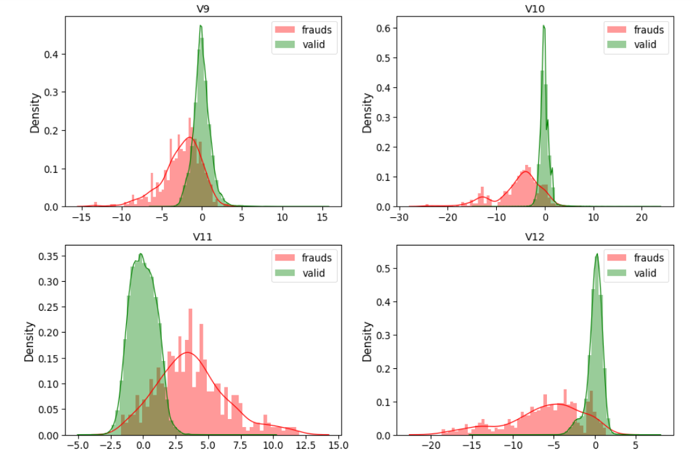
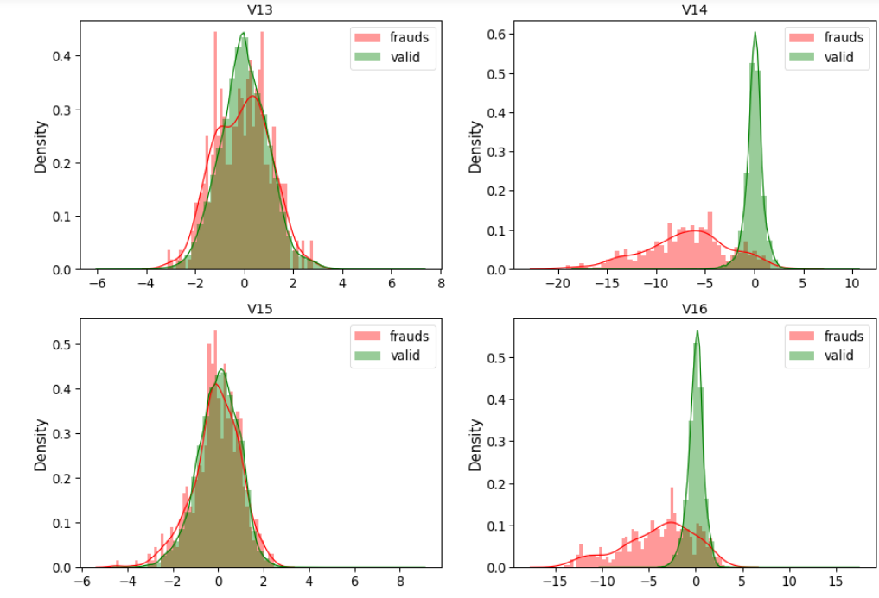
Visualizing all the features from a dataset
On graphs
For some of the features we can observe a good selectivity in terms of distribution for the two values of Class: V4, V11 have clearly separated distributions for Class values 0 and 1(we have portion of data in the right side, skew for fraud in the right and for valid is 0 ). V12, V14, V18 are partially separated, V1, V2, V3, V10 have a quite distinct profile(because the most values cluster on the right and left side). .V15,V22, V25, V26, V28 have similar profiles(they are overlap, impossible to make comparisons for two values of class.)

